Slide 1
Synopsis Presentation - Optimization of Popularity Prediction Of Video Content Using Nature Inspired Algorithms
Mentor :-
Ms. Neeti Sangwan
Presented by :-
Manan Arya 01996303116 IT(E)
Saransh Taneja 40696303116 IT(E)
Ashish Dagar 00696303116 IT(E)

Slide 2
Introduction
Online Content like articles,images ,video etc. is piling or increasing each day hence our aim is to use statistical mechanisms(regression) in order to predict the popularity of the content.
The basic idea includes optimizing feature selection using nature inspired algorithms and various other techniques; comparing all the techniques would help us reach the best possible solution.

Slide 3
Why Nature Inspired Algorithms
Retrieving data from videos is computationally very expensive and time consuming. Thus, the data available at any point of time is quite minimal and feature selection using usual algorithms is tough.
Improving the feature selection process along with the success of nature inspired algorithms over the years is the sole motivation for using these algorithms.

Slide 4
Genetic Algorithm
A genetic algorithm is a search heuristic that is inspired by Charles Darwin’s theory of natural evolution. This algorithm reflects the process of natural selection where the fittest individuals are selected to produce offspring of the next generation.
Genetic algorithms are mainly used for feature selection and optimization of other supervised and unsupervised algorithms.

Slide 5
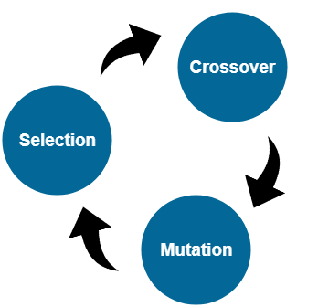
Stages Of Genetic Algorithm

Slide 7
The Data
The dataset consists of 676 different features including visual features of the videos, statistics of the videos over a period of time and user interaction with the video at various timestamps. Collected by retrieving data from over 1800+ videos, this dataset is the perfect fit for our requirement.

Slide 8
Regression
Our objective is to obtain the popularity in terms off the number of hits or views which is a constant quantity hence the aim will be realized using regression which is basically a technique to devise relation between various dependent and independent variables.
Till now during the literature review we found a technique named Support Vector Regression whose computational complexity is independent of input dimensions.

Slide 9
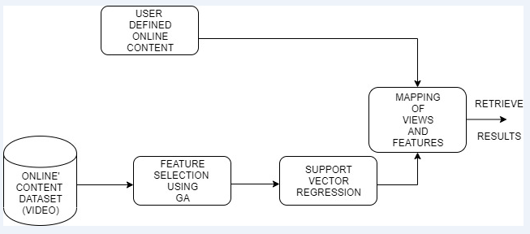
Process Flow

Slide 10
References
Predicting Popularity of Videos using Support Vector Regression - Tomasz Trzcinski and Przemysław Rokita, November 2017
Regression Model Selection using Genetic Algorithms - Sandra Paterlini and Tommaso Minevra.
Learning Fitness Functions for Genetic Algorithms - Shantanu Mandal, Todd A. Anderson, Justin Gottschlich, Shengtian Zhou, Abdullah Muzahid

